Slide 1

Visvesvaraya Technological​ University, Belagavi​
PROJECT TITLE
FACIAL EMOTION DETECTION IN REAL TIME
PRESENTED BY
HULLANAGOUDA PATIL

Slide 2



Introduction to Facial Emotion Detection in Real Time
Explore the fascinating world of facial emotion recognition using Python. Discover how to detect and analyze expressions like happiness, sadness, and anger through computer vision techniques and simple yet powerful graphics programming.

Slide 3

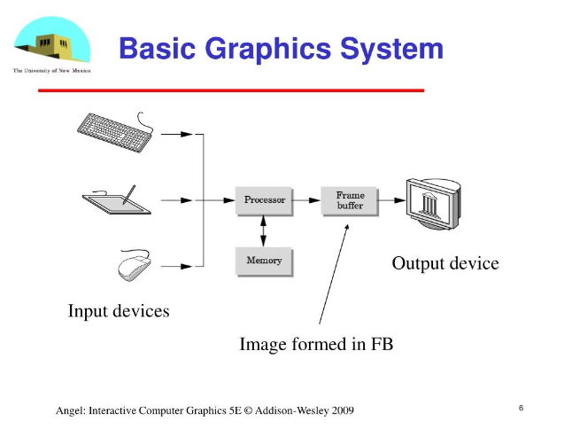
Basics of Computer Graphics
Pixels and Coordinates
Shapes and Colors
Understand the fundamental building blocks of digital images and how to represent them using pixel coordinates.
Learn to create and manipulate basic geometric shapes, and apply vibrant colors to bring your graphics to life.
Rendering Techniques
Explore rendering algorithms that translate your digital designs into visually stunning and realistic representations.

Slide 4
Representing Facial Features in Python
Landmarks
Texture and Skin
Facial Geometry
Identify and track key facial landmarks, such as the eyes, nose, and mouth, to understand the structure and expressions of a face.
Analyze the texture and skin tone of a face to enhance emotion detection and create more realistic facial representations.
Measure and model the geometric properties of a face, such as proportions and angles, to create accurate 3D facial models.

Slide 5

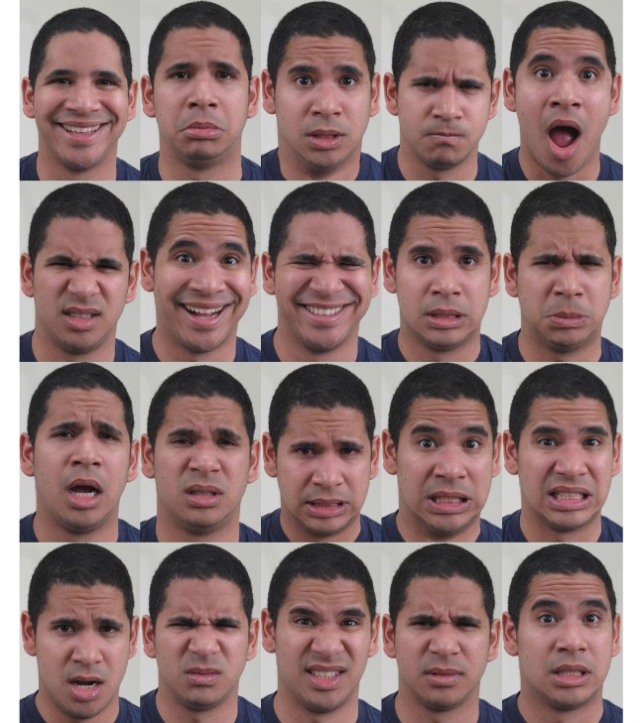
Detecting Basic Emotions: Happy, Sad, Angry, Neutral
1
Happy
2
Sad
Upturned corners of the mouth, raised cheeks, and crinkled eyes indicate a joyful expression.
Downturned corners of the mouth, lowered brows, and a furrowed forehead suggest a melancholic emotion.
3
Angry
4
Neutral
Furrowed brows, tightened lips, and flared nostrils convey a sense of frustration or anger.
A neutral, relaxed facial expression with no prominent emotional cues.

Slide 6

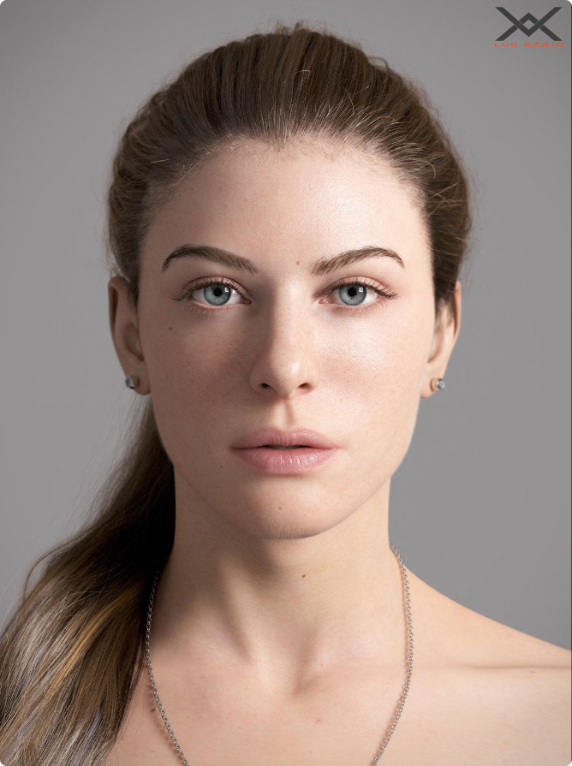



Implementing Facial Expressions using Shapes and Colors
Happiness
Use rounded, upturned shapes and bright, warm colors to depict a cheerful expression.
Sadness
Convey sorrow with downturned shapes, muted colors, and a general look of melancholy.
Anger
Sharper, angular shapes and intense, fiery colors can effectively communicate a feeling of rage.
Neutrality
Simple, balanced shapes and neutral tones can represent a calm, emotionless state.

Slide 7

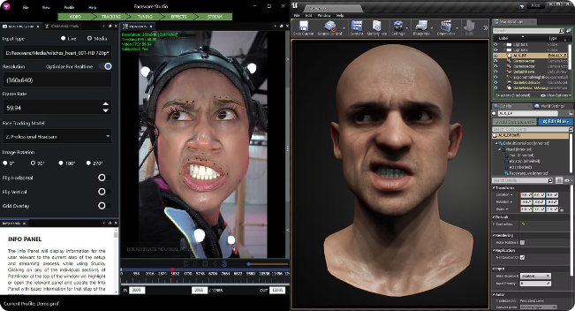
Animating Facial Emotions in Real-Time
1
Capture
Use webcams or depth sensors to capture live facial data in real-time.
2
Analyze
Quickly process the incoming facial data to detect and interpret emotional expressions.
3
Animate
Dynamically update the on-screen facial features to reflect the detected emotions in a smooth, lifelike manner.

Slide 8


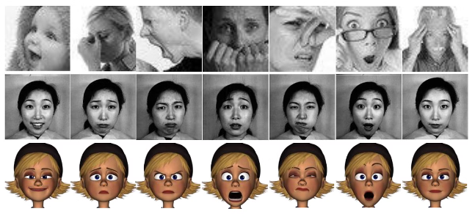


Handling Multiple Faces in a Scene
Detect
Identify the locations of all faces within the camera's field of view.
Analyze
Independently process the facial features and expressions of each detected face.
Integrate
Combine the emotion data from multiple faces to understand the overall emotional state of the scene.

Slide 9

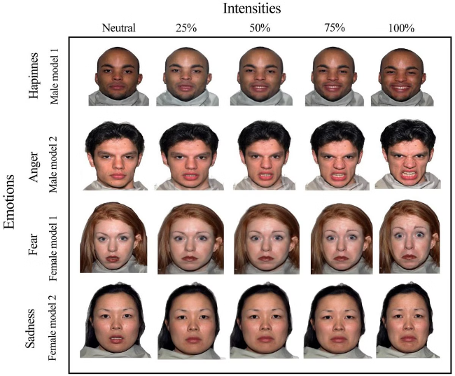
Challenges and Limitations of Emotion Recognition
1
Ambiguity
2
Diversity
Facial expressions can be subtle, complex, and sometimes ambiguous, making accurate emotion detection difficult.
Facial features and expressions can vary greatly across different cultures, ages, and ethnicities, requiring robust algorithms.
3
Occlusion
4
Context
Obstacles like hands, hair, or other objects can partially obscure the face, hindering emotion recognition.
Emotions are often influenced by external factors, making it challenging to rely solely on facial cues.

Slide 10

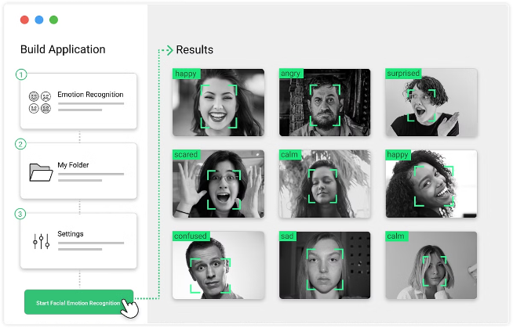
Applications of Facial Emotion Analysis
Mental Health Monitoring
Detect and track emotional states to support mental well-being and intervention.
User Experience Optimization
Analyze customer reactions to improve product design and marketing strategies.
Assistive Technology
Enable more natural and empathetic interactions between humans and machines.
Surveillance and Security
Identify potential threats by recognizing suspicious emotional patterns in public spaces.

Slide 11

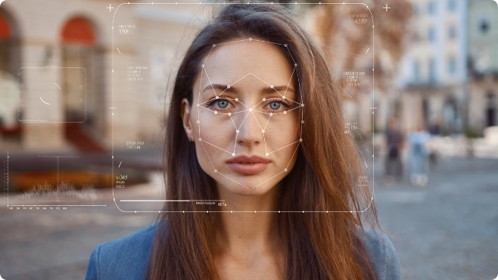
Conclusion and Future Directions
Ongoing Research
Ethical Considerations
Expect continued advancements in facial emotion recognition through machine learning, computer vision, and affective computing.
Explore the responsible implementation of these technologies to address privacy concerns and ensure fair, unbiased use.
Multi-Modal Approach
Real-World Applications
Integrate facial analysis with other modalities, such as speech, gestures, and physiological signals, for a more holistic understanding of emotions.
Discover innovative applications in healthcare, education, entertainment, and beyond to enhance human-computer interaction and improve quality of life.

